Slide 1


Characterizing the Performance of Parallel Data-Compression Algorithms across Compilers and GPUs
Brandon Alexander Burtchell and Martin Burtscher
Department of Computer Science

Slide 2

Motivation
Compilers affect the performance of programs
Compiler optimizations, library performance
NVIDIA GPUs can run CUDA code
Compiled by NVCC or Clang
NVIDIA and AMD GPUs can run HIP code
Compiled by HIPCC
HIPIFY converts CUDA to HIP
Are there performance differences when the same compressor is compiled by different compilers?

Slide 3


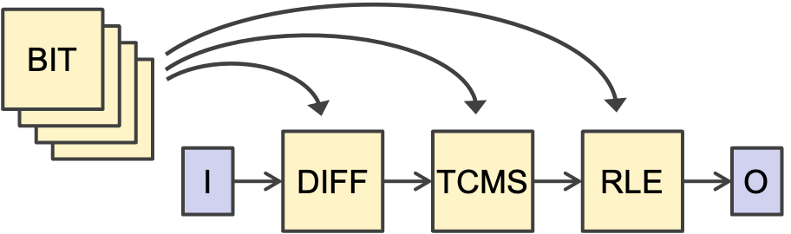
LC Framework
burtscher/LC-framework
LC generates compression pipelines from a library of data transformations (components)
Some components reduce the data size (reducers)
Others modify data to expose redundancies
62 components and 3 stages yields 107,632 pipelines
Position of component can affect runtime

Slide 4
Overview
Update LC for compatibility with compilers for NVIDIA and AMD GPUs
Measure performance of 62 components from LC
Identify interesting performance trends between codes on several GPUs

Slide 5



Background: Compilers
NVCC
NVIDIA’s proprietary CUDA compiler
Clang
Open-source, LLVM-based
Supports CUDA
HIPCC
Compiles HIP code (CUDA-like)
For NVIDIA GPUs: Calls NVCC, includes HIP libraries

Slide 6
Background: Component Types
Mutators (no compression)
Computationally transform each value in place
Shufflers (no compression)
Rearrange the order of values
Predictors (no compression)
Guess the next value from prior value(s)
Compute residuals that cluster around zero
Reducers
Compress data

Slide 7
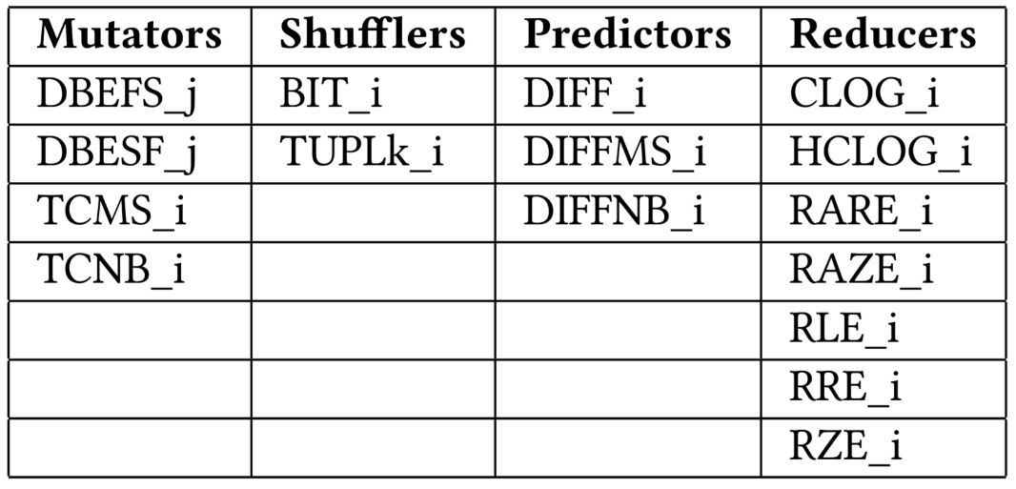
Evaluated Components
i/j refer to the wordsize of the component (1, 2, 4, 8 bytes)
Components have diverse algorithmic complexities

Slide 8
Updating LC for Compatibility
HIPIFY handles find-and-replace function names
E.g., cudaMemcpy() → hipMemcpy()
Work around unsupported primitives
E.g., block-scope atomics are not supported on HIP
Solution: Fall back to device-scope atomics on HIP
Update code to support 64-thread warpsize
Required by certain AMD GPUs

Slide 9

Evaluation Methodology
Record encoding and decoding throughputs for all pipelines on all inputs
Repeat for each tested compiler
On each compatible GPU
Compression ratio is always equal
Aggregate throughputs across each dimension
Word size (1, 2, 4, 8 bytes)
Component type (mutator, shuffler, etc.)
Component (TCMS, TCNB, DBEFS, etc.)

Slide 10
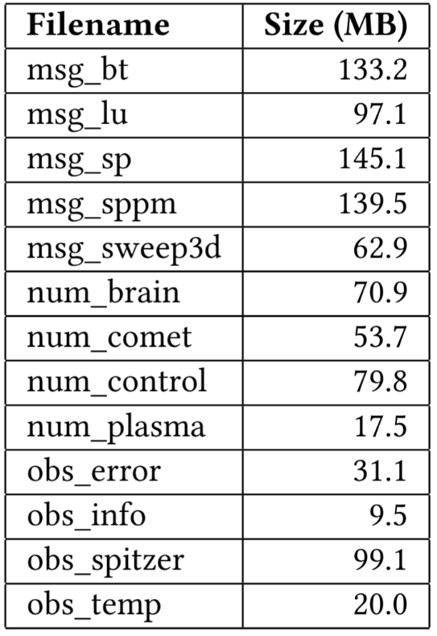
Evaluation Methodology
NVIDIA GPUs
TITAN V, RTX 3080 Ti, RTX 4090
AMD GPUs
MI100, RX 7900 XTX
13 inputs from SP dataset [1]
Record median of 3 runs
Compiled with optimizations on
[1] M. Burtscher and P. Ratanaworabhan. "High Throughput Compression of Double-Precision Floating-Point Data." 2007 Data Compression Conference, pp. 293-302. March 2007.

Slide 11
Results

Slide 12
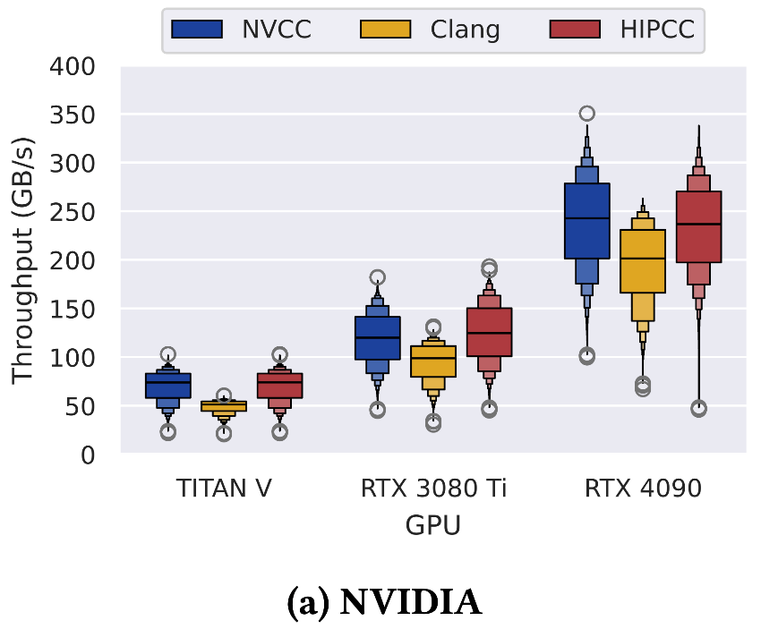
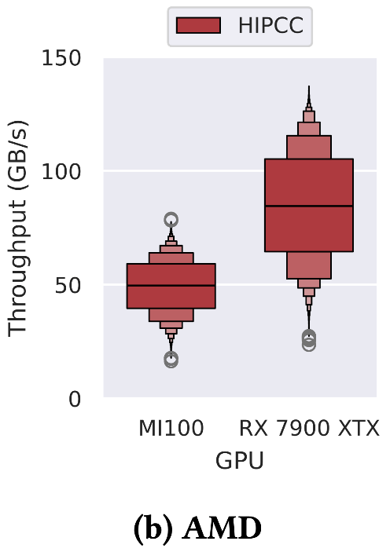
Comparing GPUs (Encoding)
NVCC and HIPCC are consistently close (HIPCC invokes NVCC)
Clang is slower for encoding
Notes:
Each box represents the throughputs of all 107,000 pipelines.

Slide 13
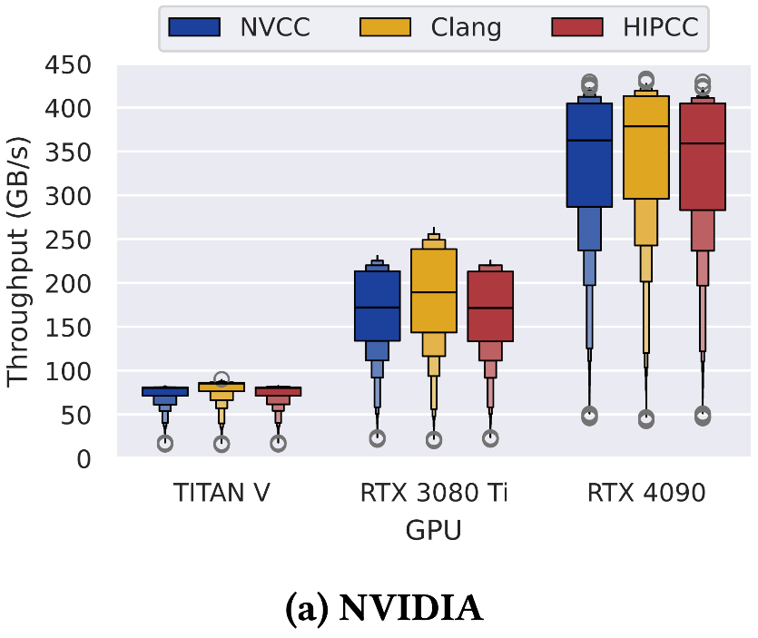
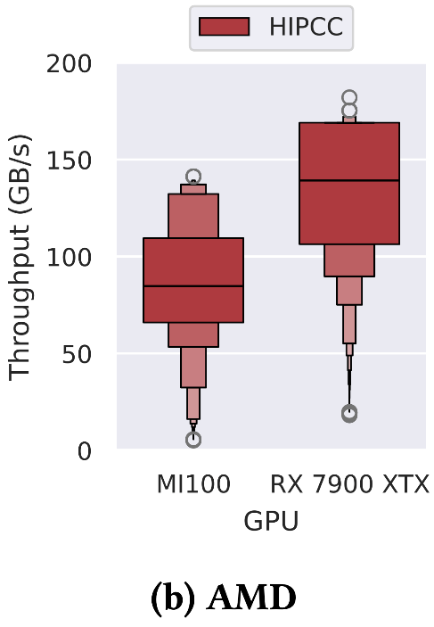
Comparing GPUs (Decoding)
Clang is faster for decoding
Decoding throughput distributions trend upwards
Notes:
Each box represents the throughputs of all 107,000 pipelines.

Slide 14
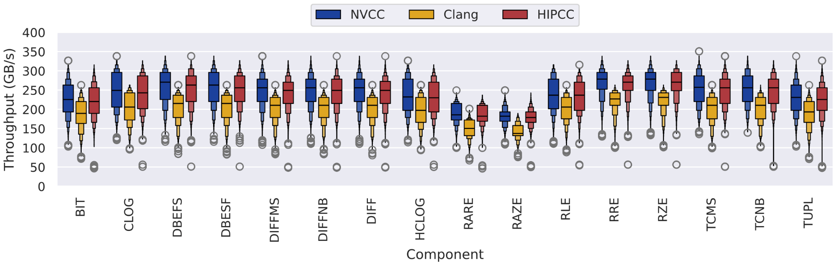
Stage-1 Component (Encoding)
Reducers vary more than other types
On RTX 4090, pipelines with component in Stage 1
Same trends on other GPUs
Notes:
Each box represents the throughputs of roughly 7,000 pipelines.

Slide 15
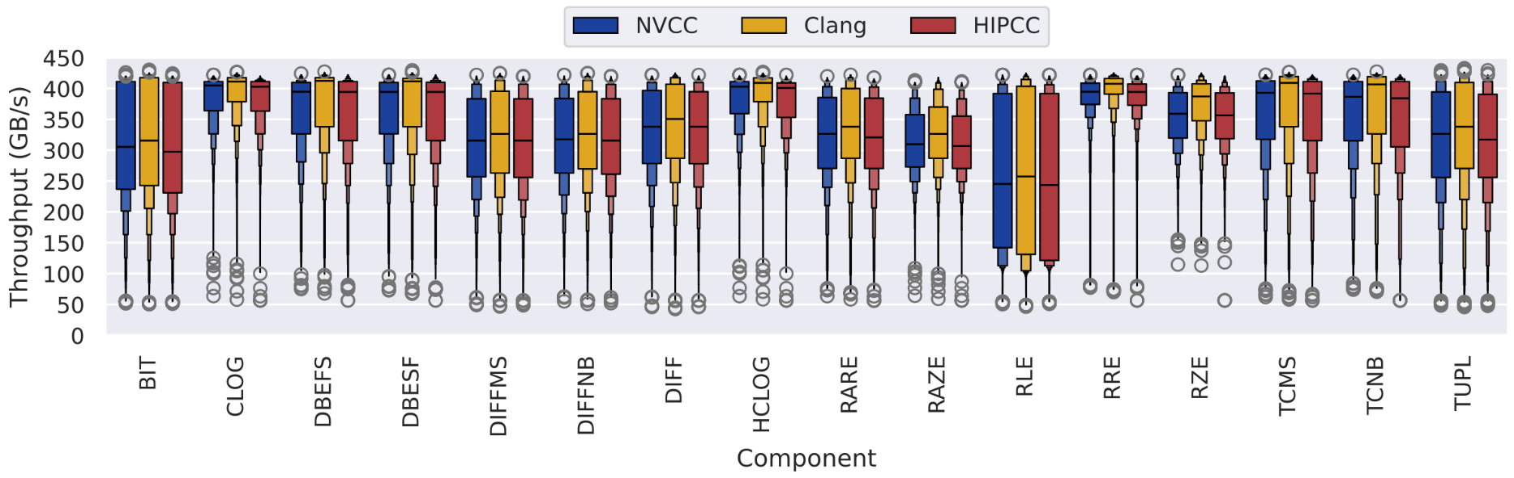
Stage-1 Component (Decoding)
Larger spread in middle 50%
BIT and RLE do not follow same trend as other components
Despite belonging to different types (shuffler vs. reducer)
Why? Let us investigate…
Notes:
Each box represents the throughputs of roughly 7,000 pipelines.

Slide 16
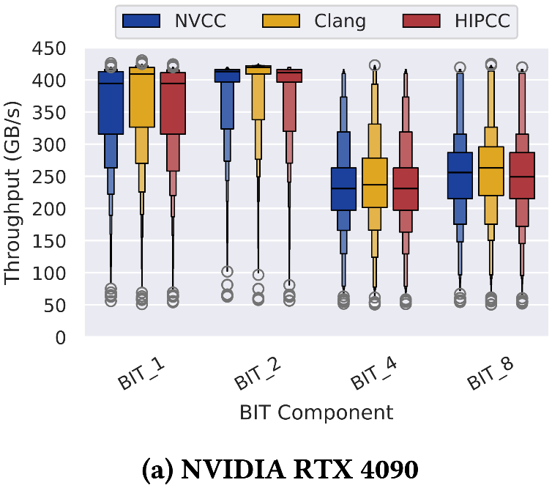
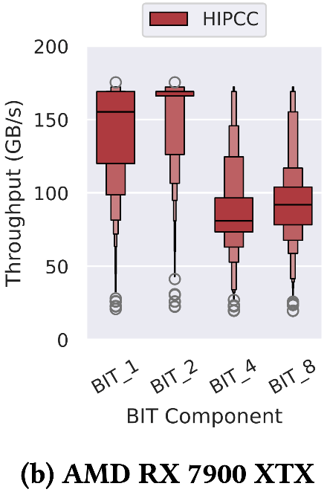
BIT in Stage 1 (Decoding)
BIT performs a bit shuffle
Different implementations based on word size
BIT_4/8 require synchronization, BIT_1/2 do not
Notes:
Each box represents the throughputs of roughly 1,700 pipelines

Slide 17
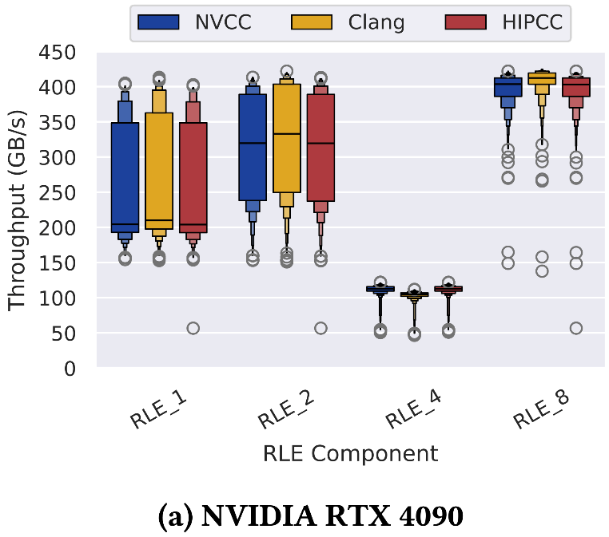
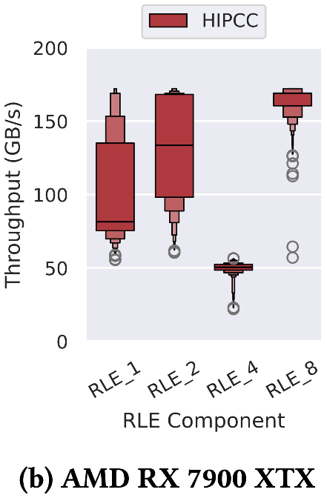
RLE in Stage 1 (Decoding)
RLE performs run-length encoding
Note: LC skips decoding chunks that failed to compress
RLE is slowest for 4-bytes, which matches 4-byte float data

Slide 18
Summary and Conclusions
Negligible difference between NVCC and HIPCC
Clang: slower encoding, faster decoding
See paper for details
Interesting performance trends for compressors
NVIDIA and AMD GPUs behave similarly
Reducers show most throughput variability
Full paper: word-size comparison and more
Acknowledgements
U.S. DOE, Office of Science, Office of ASCR (DE-SC0022223)

