Slide 1


Building n-Dimensional Trees for Resolution-Based Progressive Compression
Brandon Alexander Burtchell and Martin Burtscher
Department of Computer Science

Slide 2

Introduction
Data is often compressed to reduce storage space
Still, compressed data can be quite large
  E.g., floating-point data in science
A user might not be able to download entire data
  User can only download low-fidelity version
  But wants access to higher fidelities as a contingency
How can we provide multiple fidelities without maintaining multiple versions of the data?

Slide 3


Progressive Compression
Refactor data into a hierarchical series of representations
  Existing works typically vary resolution or precision
Users download data at initial fidelity
  Can later download at higher fidelities as needed
We investigate if compressing each level with a different compressor improves compression ratio

Slide 4
Overview
Outline resolution-based progressive approach
Demonstrate competitive compression ratios compared to traditional lossy compression
Analyze effect of progression on quality of data

Slide 5


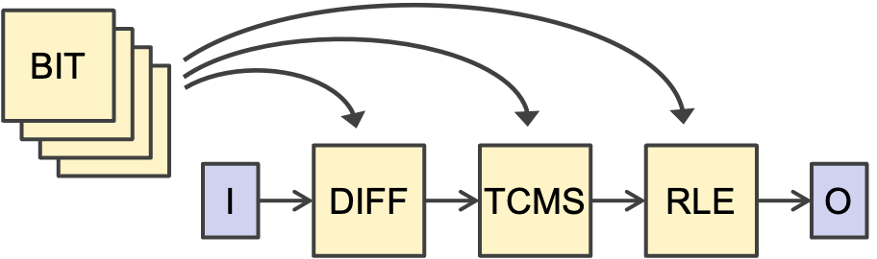
Background: LC Framework
burtscher/LC-framework
LC generates compression pipelines from a library of data transformations (components)
  Some components reduce the data size (reducers)
  Others modify data to expose redundancies
69 components and 3 stages yields 171,396 pipelines

Slide 6
Approach: Quantization
Floating-point data is often quantized as the first step of lossy compression
  Translate floats into integer “bins”
  Based on user-defined error bound
For this progressive approach, quantization establishes the maximum base fidelity

Slide 7
Approach: Tree Encoding
The sum of each group (pair) becomes the parent
To encode, drop one child from each group
Layer 0
1
+
2
3
+
4
5
+
6
7
+
8
Layer 1
3
+
7
11
+
15
Layer 2
10
+
26
Layer 3
36
Encoded Output:
36 | 10 | 3 | 11 | 1 | 3 | 5 | 7

Slide 8
Approach: Full Decoding
To decode, subtract left child from parent
Repeat down to layer 0
Encoded Input:
36 | 10 | 3 | 11 | 1 | 3 | 5 | 7
Layer 3
36
-
Layer 2
10
=
26
-
-
=
11
=
15
Layer 1
3
7
-
-
-
-
1
=
2
3
=
4
5
=
6
7
=
8
Layer 0

Slide 9
Approach: Partial Decoding
Stop at any layer and divide value by number of children
Repeat until averaged down to layer 0
Encoded Input:
36 | 10
Layer 3
36
-
Layer 2
10
=
26
÷2
÷2
Layer 1
5
5
13
13
÷2
÷2
÷2
÷2
Layer 0
2
2
2
2
6
6
6
6

Slide 10
n-Dimensional Support
Groups change according to dimensions of input
  1D: pair of 2 values
  2D: square of 4 values
  3D: cube of 8 values
  nD: hypercube of 2^{n} values
…

Slide 11
Layer Compression
Compress each layer with its own LC pipeline
  Each layer may exhibit different data patterns
Experiments reveal best pipeline for each layer
Layer 0
Layer 1
Layer 2
Layer 3

Slide 12
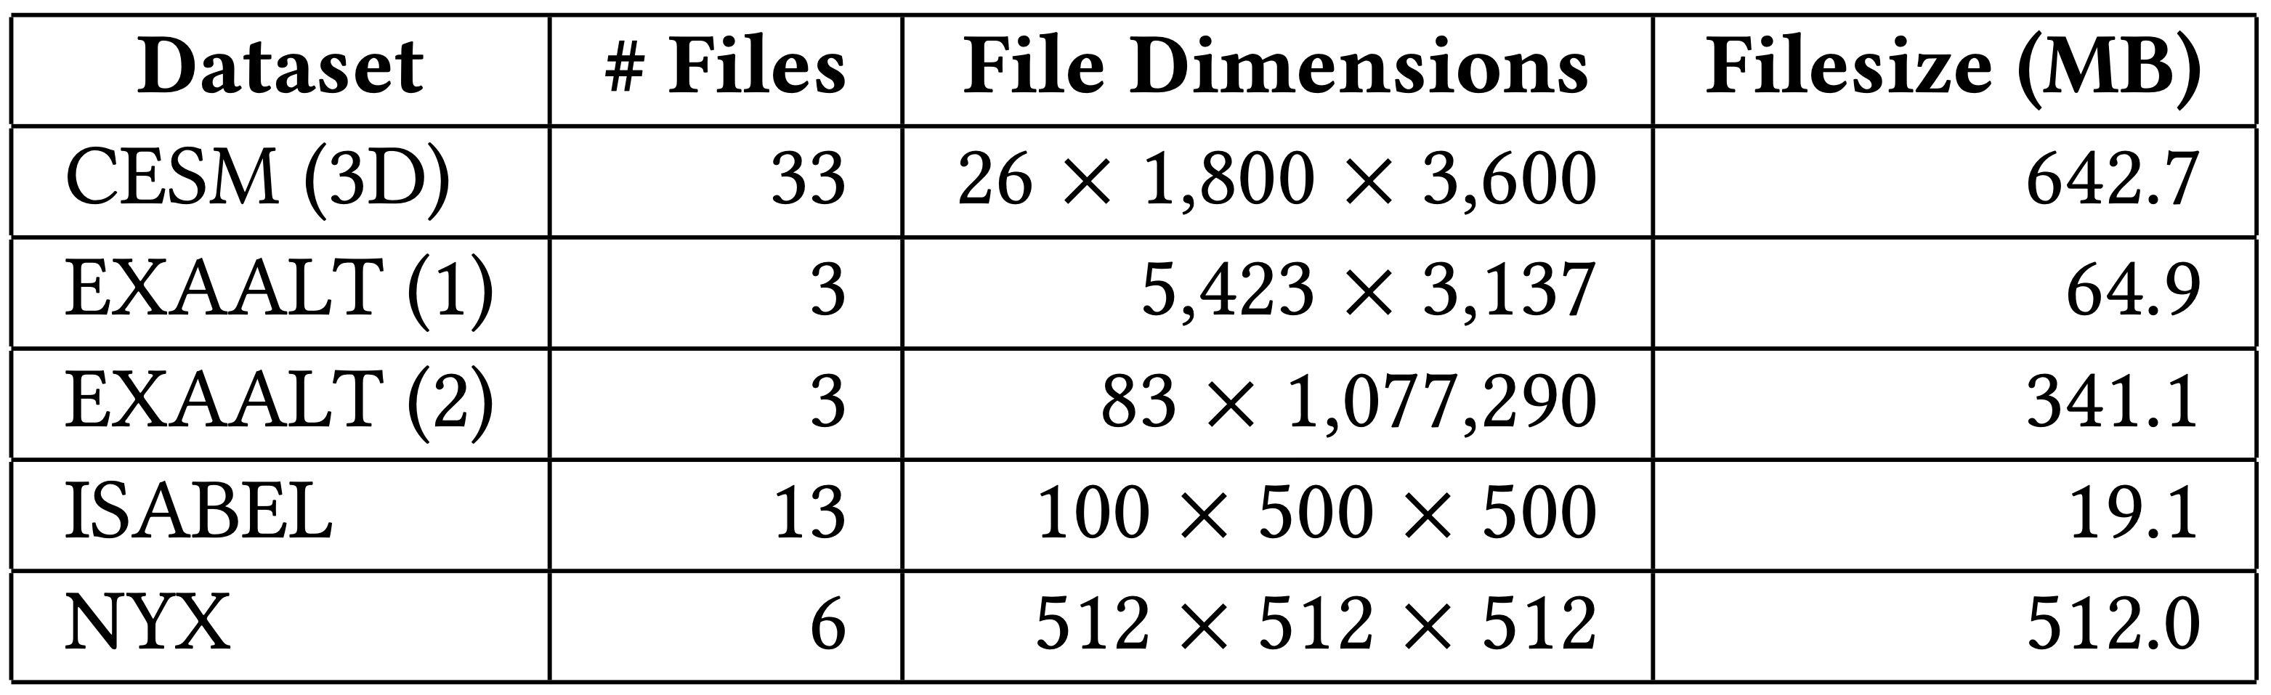
Experimental Methodology
Inputs from SDRbench (https://sdrbench.github.io/)
Normalized absolute error bounds: 10⁻³, 10⁻⁴, 10⁻⁵, 10⁻⁶
LC search: 3-stage pipelines

Slide 13
Results

Slide 14
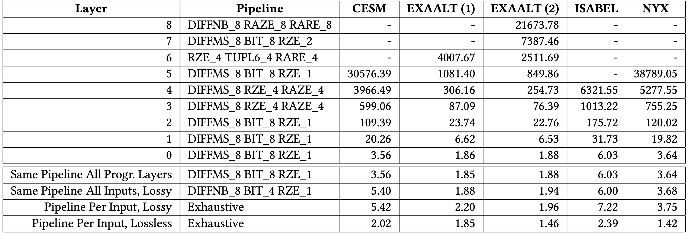
Running Compression Ratio (CR)
Different best LC pipelines!
Same pipeline for each layer is sufficient
Full progressive decoding > lossless CR
Any intermediate layer > traditional lossy CR
Running CR: accumulated data from user’s perspective
  Original size ÷ (encoded layer 5 + encoded layer 4 + …)

Slide 15
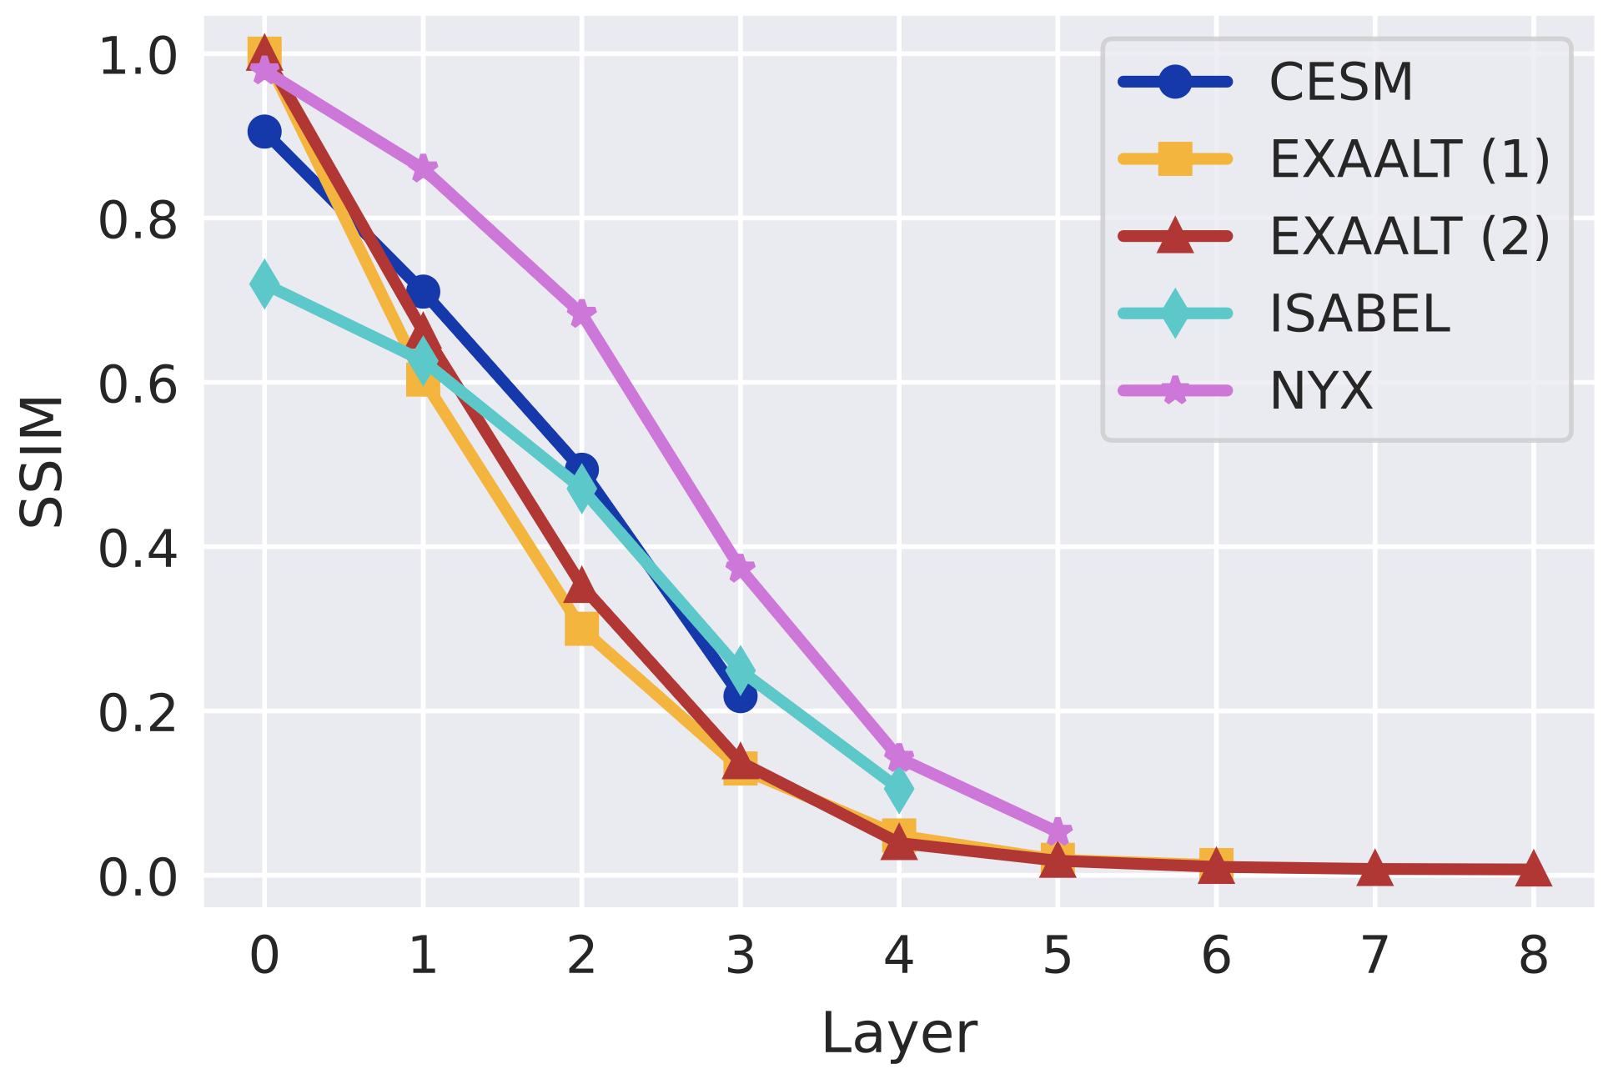
Structural Similarity
Layer-0 SSIM is determined by error bound
SSIM expectedly declines as we progress

Slide 16
Results Discussion
Weaknesses
  Cannot guarantee error bound beyond layer 0
  Summing quantized bin numbers with unquantizable float values introduces unpredictable error
Strengths
  Progressive retrieval for n-dimensional data
  Ability to stop decoding at any desired layer

Slide 17
Conclusions
Our approach offers multiple fidelities with one encoded representation
Same pipeline for each layer is sufficient
CRs are competitive with traditional compression
But loss of quality limits use cases
Future work: guarantee error bounds
Acknowledgements
U.S. DOE, Office of Science, Office of ASCR (DE-SC0022223)
SDRBench: DOE NNSA ECP project, ECP CODAR Project

